Slide 2
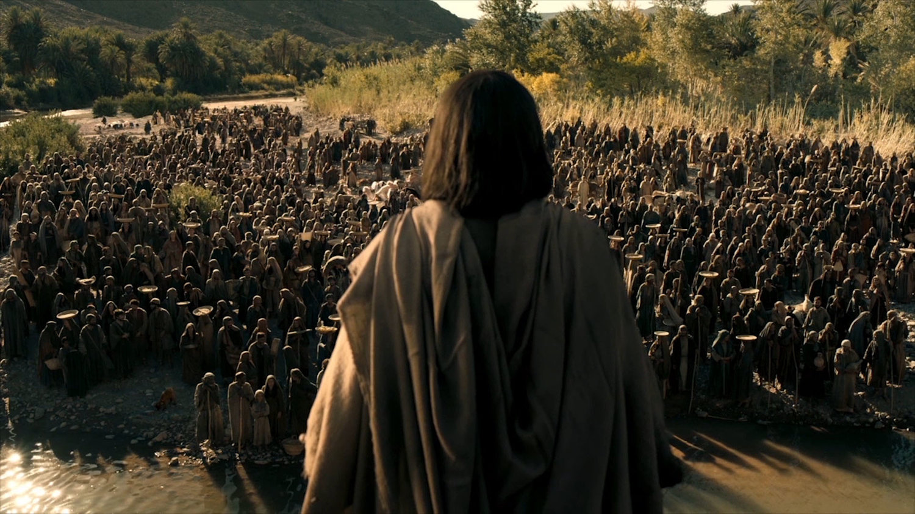
Jesus and our BIG questions
Luke 13:1-9

Slide 3
Why do people suffer?
Not Karma
Not Supply and Demand

Slide 4
Why do people suffer?
Wickedness
Suffering

Slide 5
Why do people suffer?
Righteous
Suffering

Slide 6
Why do people suffer?
Not Karma
Not Supply and Demand
Inherited Curses
Rather… it points us to
something greater.

Slide 7
What does God care about?
Spiritual > Physical
Eternal > Temporal
Repenting > Sinning

Slide 8
Is God Overly Strict?
“One more chance”
This is all of our stories

Slide 9
Does God have
unlimited Patience?
No. it eventually runs out.
Everyone has a last chance
(Rom. 1:24f, 2 Thess. 2:11-12)

Slide 10
Have you heard Him?

